Slide 1
Cognitive Dissonance Theory

Slide 2
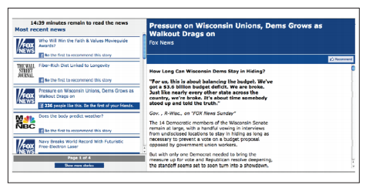
Hypothesis 1: Selective Exposure Prevents Dissonance
We tend to “stick with our own kind”
Selective exposure: The tendency people have to avoid information that would create cognitive dissonance because it’s incompatible with their current beliefs

Slide 3

Hypothesis 2: Post-decision Dissonance Creates a Need for Reassurance
Strong doubts experienced after making an important, close-call decision that is difficult to reverse
We will often change our perceptions to reduce dissonance and make our decisions seem more attractive

Slide 4
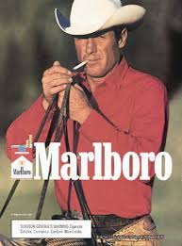
Hypothesis 3: Minimal Justification for Action Induces a Shift in Attitude
Conventional Wisdom =
Attitude → Behavior
Minimal Justification Hypothesis = Behavior → Attitude

Slide 5

Counter-Attitudinal Advocacy
  Publicly urging others to believe or do something that is opposed to what the advocate actually believes
“Would I Lie for a Dollar?”
A | B | C | D
Attitude/Behavior Inconsistency | Dissonance Created | Attitude Change | Dissonance Reduced
Festinger’s Process Model of Cognitive Dissonance

