Slide 1

Todd, Bradon, Spencer, Justin, Karl

Slide 2
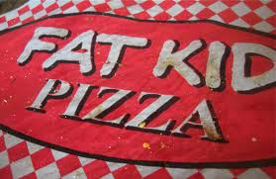
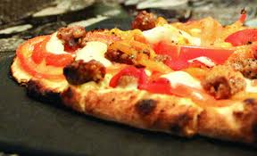
Fuh-Get-About-It!
Qualities
Serves Authentic East Coast Dishes
Known For 20 Inch Pizza Pies
Fun Atmosphere
The Best New York Style Pizza in Utah
Bar Scene

Slide 3
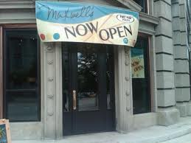
Maxwell’s Comes To SLC!
Grand Opening June 25, 2011
Located Downtown in Historic Boston Building
Open Daily From 11:00 a.m. – 1:00 a.m.
Same Great Pizza and Food as Park City Location
Club Atmosphere During Evening Hours

Slide 4
Comparing the Locations
Maxwell’s Park City
Maxwell’s Salt Lake City
Good Location (Tourists)
Loyal Following
Word Of Mouth Advertisements
Busiest Restaurant In Park City
More Competitive Location
No Established Customer Following
Advertising Struggles

Slide 5
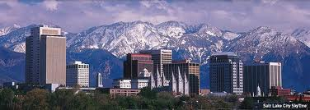
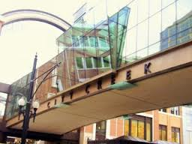
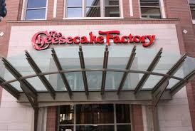


More Competitive Location
Salt Lake City is 25 Time Larger Than Park City
Opening a New Restaurant in a Well Developed Area
Highly Competitive Market

Slide 6
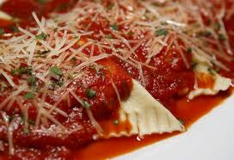
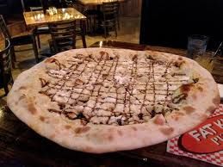
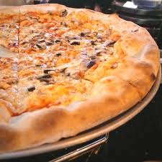
Lack of Loyal Customer Following
Can’t Rely on Word-of-Mouth Advertisements Only
Must Reach New Clientele in New Area

Slide 7

Advertisement Struggles

Slide 8
More Advertisement Mistakes

Slide 9
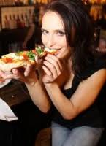
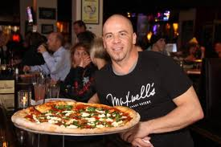
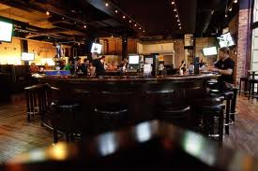
Salt Lake Location Positives
Great Online Reviews
Same Great Food
Fun Atmosphere
Great Hours
Great Feedback From In-Store Reviews

Slide 10
Maxwell’s SLC
Online Reviews
Positive Feedback

Slide 11
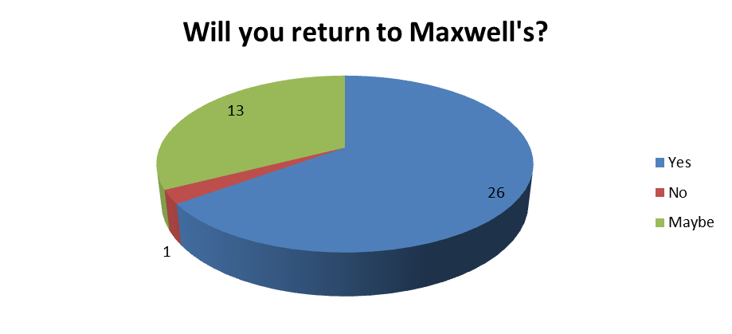
More Positives
In-Store Results

Slide 12
Recommendations
Marketing Campaign Via Internet, Radio, Television & Print that are Family-Friendly
Focus on Quality of Food and Great Pizza
Show Off the Lively Atmosphere & Use as Focus to Reach New Customers
Develop Loyal Customers Through Continually Provided the Best Food, Service, & Atmosphere for the Customers

Slide 13
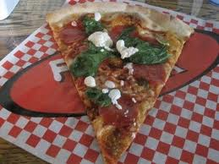
Fuh-Get-About-It!!

