Slide 1

SUPPLEMENTAL INSTRUCTION
Ashley Jewell, Bradon Fennell, McKenzie Cherrington, & Preston Richards

Slide 2
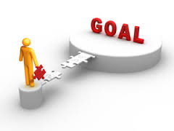
CURRENT SITUATION
Students and faculty are relatively unaware of the program or its benefits
Opportunity to initiate a marketing plan that will help inform the key targets

Slide 3
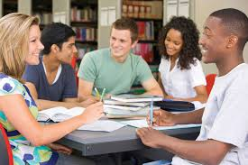

GOAL
Create awareness among students and faculty
Motivate students to attend study sessions
Encourage students to participate as SI Leaders

Slide 4



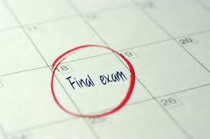
OBJECTIVES
Implement social media marketing strategy by Oct. 31, 2014
Create all informational material by Nov. 10, 2014, to better market the program
Increase SI study session participation by 25% during finals week

Slide 5
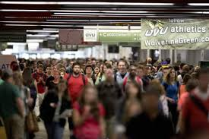

KEY PUBLICS
Current UVU students
Tutors
Student-Athletes
Current UVU teachers

Slide 6


STRATEGIES
Implement social media marketing strategy
Create informational material that will better inform key targets
Initiate the “Finals Countdown” phase of the marketing plan, to increase student participation

Slide 7

Social Media Tactics
Establish Facebook, Twitter & Instagram accounts
Provide links to social media profiles on UVU website
Create profiles for all SI leaders
Post content that coincides with SI program schedule, study sessions & SI events

Slide 8
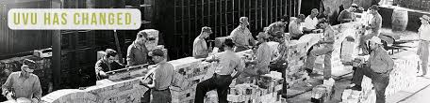
Informational Materials Tactics
Meet with SI leaders & staff to determine amounts of material necessary
Create T-shirts for SI leaders to distinguish themselves as SI employees
Design posters, fliers, swag, etc. using on campus resources
Create digital signage designs that will be featured around the campus

Slide 9

“Finals Countdown” Tactics
Provide food at all group study sessions during the “Finals Countdown”
Hand out fliers promoting the study sessions
Host trivia/game nights during finals week & give out swag for prizes
Create signs, fliers & posters specifically promoting the “Finals Countdown”
Correlate with faculty to help spread the word
Feature the “Finals Countdown” on social media sites, UVU website & the UVU review

Slide 10

BUDGET
$500-$1000 budget for the year
Use of on-campus resources
Utilize low-cost marketing ideas (i.e. social media and digital posters)
Brochures & Fliers | SWAG & T-Shirts | Posters | Food & Candy | Total
$100 | $250 | $100 | $300 | $750

Slide 11
Goal:
Awareness, Attendance & Participation
Objectives:
Implement social media, create informational materials, increase attendance
Key Publics:
Students, Tutors, Student-Athletes & Teachers
Strategies:
Social media marketing, marketing materials & “Finals Countdown”
Tactics:
Social Media accounts, create publicity materials & “Finals Countdown” promotional pieces and events

