Slide 1
Social responsibility theory
Rob Horn, Bradon Fennell, Cody Pike, Tali Ngatuvai, & Kevin Black

Slide 2


Definition of social responsibility theory
Social responsibility- an ethical framework which suggests than an entity, be it an organization or individual, has an obligation to act for the benefit of society at large

Slide 3
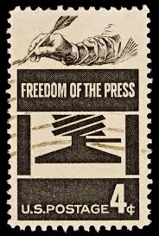
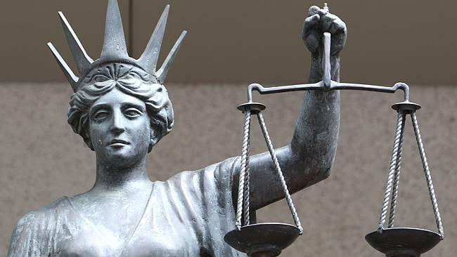
The beginning of social responsibility in the media
Hutchins Commission 1947
Discussed proper function of the media in a modern democracy
The press plays large role in the development and stability of a society
Social responsibility needed to be imposed on the mass media

Slide 4



Outcomes from the Hutchins commission
Press has the moral obligation to consider the overall needs of society
Journalistic decisions should be made in order to produce the greatest good
Media should provide citizens with the information needed to govern themselves

Slide 5


What is the Media’s social responsibility?
Duties of the Media
Tell the truth
Avoidance of harm toward their constituents
Credibility
Provide information to public which allows individuals to fulfill their roles as citizens
Provide information that both informs and entertains

Slide 6



Duties continued
Become actively involved in the community
Contribute to society as a whole
Recognize the nature of their claims
Work to improve life within their social realm
Promote understanding among all publics
Inform the public on matters that they would otherwise have little knowledge

Slide 7
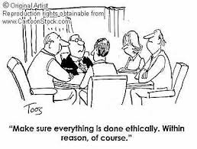
Disadvantages of srt in the media
The media today is not constituted the same way as the country’s founders envisioned
Media don’t always make decisions based on the public’s interest
Are entertainment segments filled with the public’s interest in mind?
Media must also earn money and cannot always base decisions on the interest of the public

Slide 8

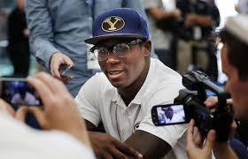
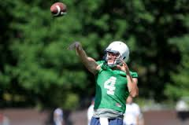
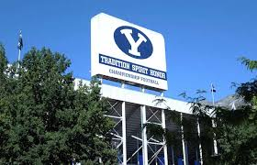
CASE study #1
2014, rumors surfaced regarding NCAA investigation at BYU
1280 radio hosts began speculating the seriousness of the investigation
1280 reported that players received illegal benefits such as money, cars, “sex house”, etc.
Reported that BYU would have a one year ban from collegiate athletics
Rival news station, 1320, took a “wait-and-see” approach

Slide 9
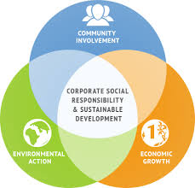



Social Responsibility in the corporate world
SRT in Corporation- The idea that a business or corporation should embrace its social responsibilities and not be solely focused on maximizing profits. The focus is to develop good business by maintaining positive relationships to the surrounding society the business operates in.
SRT in business...

Slide 10
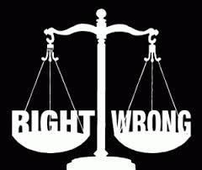
HISTORY OF SRT IN THE CORPORATE WORLD
James Grunig
Milton Friedman
At the very least, an organization should perform its basic task (Natural Binding)
Take care of any potential consequences of its primary task, such as cleaning up pollution it has caused, or being a good employer, or responding to complaints (Natural Binding)
Organizations may move into the area of general societal concerns such as literacy, disease prevention, and hunger
“Social responsibilities of business are notable for their analytical looseness and lack of rigor.”
Believed that only people could have social responsibilities. Businesses, by their very nature, cannot

Slide 11



ADVANTAGES OF SOCIAL RESPONSIBILITY
Some investors use a company’s social responsibility - or lack thereof - as an investment criterion.
“Corporate social responsibility ensures that companies and corporations accept the notion of being responsible to society beyond merely providing goods or services that benefit the public on a functional level.”

Slide 12
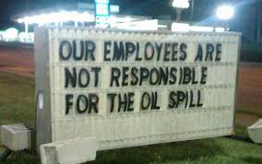
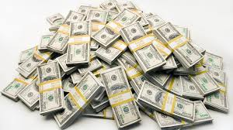
DISADVANTAGES OF SOCIAL RESPONSIBILITY
Belief that the actual responsibility of a business falls on its owners and shareholders
Belief that a business should be held accountable for all of their actions (past, present, future) that impact the environment and community
Purpose of business is to make a profit for the benefit of shareholders… doing anything outside of this purpose undermines this fundamental business principle

Slide 13
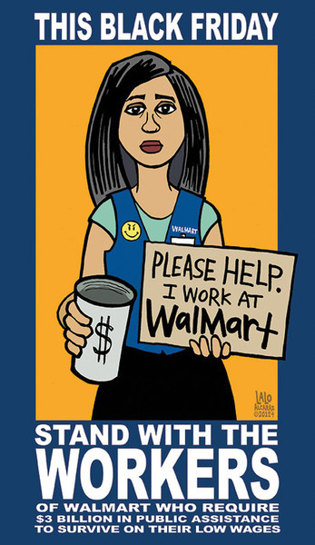
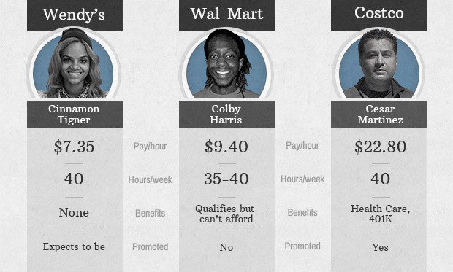
Disadvantages continued
Decision-making processes cause more issues within larger corporations than small businesses
Cost to the company
Enhanced scrutiny
Philanthropy
Walmart’s poor labor practices vs Costco’s employee benefit package

Slide 14
SOLUTIONS
Zena James
5 Ways to Create a Socially Responsible & Profitable Company
  Help the organization demonstrate its fundamental approach to CSR
  Ensure that efforts are not misinterpreted
  Make sensible use of existing and external communications tools to substantiate the organization’s commitment
  The Office
BOGO: Buy-One-Give-One
Portion of Profits Donated
Transparency and Call-to-Action
Employee Volunteerism
Employee Incentives

Slide 15

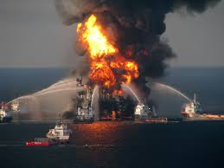
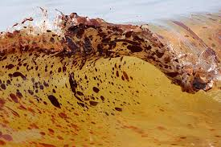
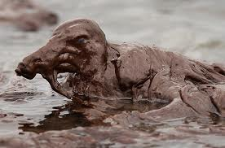
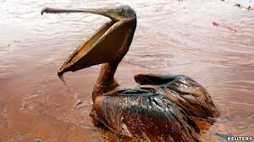
Case Study #2
April 2010, explosion on BP oil rig, Deepwater Horizon
11 people were killed and oil began leaking from ship (5,000-100,00 barrels per day)
BP’s CEO initially said the spill was “very modest” and “relatively tiny”
Later changed his tone and called the spill an “environmental catastrophe”
BP shares fell 30% during the spill and aftermath of the spill

