Slide 1
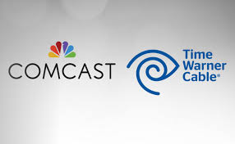
The Merger of Comcast & Time Warner Cable
Andy Neff, Bradon Fennell, Clint Monsen, & Kyle Borne

Slide 2
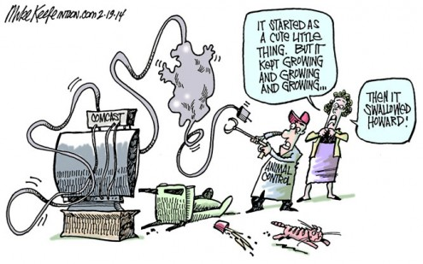
Core Problem
Comcast proposing to buy Time Warner Cable in a deal that would combine the two biggest cable companies in the United States

Slide 3
Primary Research
Are you or have you ever been a Comcast or Time Warner Cable subscriber?
Yes: 24 No: 16
Overall, are/were you satisfied, dissatisfied, or neither satisfied nor dissatisfied in doing business with Comcast or Time Warner Cable?
Have you heard about Comcast buying out Time Warner Cable?
Yes: 21 No: 19

Slide 4


Do you think Comcast's image will be positively or negatively affected with this buyout?
Negatively: 14
Positively: 16
Not Sure: 10
Do you have any concerns with this merger between Comcast and Time Warner Cable?
Yes: 20
No: 18
Not Sure: 2
“Yes, there will be no competition and Comcast will be able to set the price at whatever they want”

Slide 5
Secondary Research
STRENGTHS | WEAKNESSES | OPPORTUNITIES | THREATS
Well Known Company | Customer Service Reputation | Increase Profits | Competitors
High Quality Service | Limited Geographics | Expanded Into Over 40 States | FTC
Advanced Technology | Public’s Perception of Potential Monopoly | Increase Technology | Media

Slide 6
Secondary Continued
Industry
Competition
In 2013, the cable industry accounted for 34 percent of the nearly $150 billion invested in the US economy which comes out to nearly $51 billion
Combining both Comcast and Time Warner would bring Comcast’s US customer base to 200 million subscribers nearly doubling the rest of the competition
Dish Network
DirecTV
Time Warner Cable
AT&T U verse
Charter Communications

Slide 7
Continued
The Client
Promotions
Currently, Comcast is the largest US cable and broadband provider with over 113 million subscribers
Comcast was crowned “Worst Company in America” according to consumer reports
During promotional periods that introductory price can be found to last for the first 12 months for the customer, at which point the price increases
If you bundle your cable and broadband service with a Verizon cell phone package then you qualify for a $300 VISA gift card

Slide 8

Key Publics
Media
Needs to be pitched across different channels to promote public benefits
Implications for broad publics must be expressed and properly reached

Slide 9
Key Publics
Comcast & Time Warner Cable Customers
Government Regulators (FTC and FCC)
Customers need to feel assured of continued service & bargain
Time Warner customers need to see bargain and added valued
Need to be convinced of legality and strengths of merger
Economics and stability of the issue must be proven
Benefits such as broader coverage need to be expressed (Internet)

Slide 10


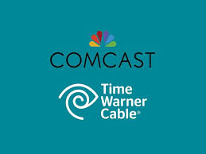
Goal
To make the Regulators aware of the benefits that will follow the merger of Comcast and Time Warner Cable and also to improve Comcast’s overall image

Slide 11
Objectives
Gain FTC approval for the merger by July 1, 2014 by creating a presentation that highlights the benefits of the merger
Increase public perception by 5% by the end of the year

Slide 12
Key Public - FCC
Strategy
Tactics
Set up a meeting with the FTC board on April 1, 2014 to outline the benefits of the merger
  Present data on reaching more rural customers
  Increase in service area by 11 percent
  Increase broadband speeds by 30 percent

Slide 13
Key Public - Media & Public
Strategy
Tactics
Create a website to enhance public awareness and to provide basic information regarding the benefits of the merger
  Create link to merger website on all Comcast and Time-Warner websites to drive traffic
  Have opt-in email subscription to receive latest news on merger
  Allow the public to speak directly to a customer service representative to discuss the new cable options available to the public

Slide 14
References
Broadband Now. (2014, March). Retrieved from Comcast - Broadband Now: http://broadbandnow.com/Comcast Comcast Investor Relations. (2014, March). Retrieved from Comcast Earnings: http://www.cmcsa.com/releasedetail.cfm?ReleaseID=821438
Comcast international programing. (2014). Retrieved from http://www.comcast.com/Corporate/Programming/international-programming
Comcast reports 4th quarter and year end 2013 results. (2014, January 28). Retrieved from http://www.cmcsa.com/releasedetail.cfm?ReleaseID=821438
Comcast Service. (2014, March 24). Retrieved from Cable TV: http://www.cabletv.com/comcast/availability-map
Demographics. (2011). Retrieved from Journalism.org: http://www.journalism.org/2011/05/09/demographics/
Management, O. o. (2007). Federal Employee Demographics. U.S. O.P.M.
NCTA. (2014). Retrieved from Industry Data: https://www.ncta.com/industry-data
PR Newswire. (2010, April 26). Retrieved from Comcast Is Crowned Consumerist.Com's 2010 Worst Company In America: http://www.prnewswire.com/news-releases/comcast-is-crowned-consumeristcoms-2010-worst-company-in-america-92097574.html
Ramachandran, S., & Sharma, A. (2014, March 11). The Wall Street Journal. Retrieved from Industry Balks at Deal for a Cable Giant:
Sonlte. (2014, March 24). Time Warner Coverage Map. Retrieved from
Sonlte: http://www.sonlte.com/tag/time-warner-cable/
Stelter, B. (2014, February 14). Comcast Buys Time Warner for $45 Billion. Retrieved from CNN Money: http://money.cnn.com/2014/02/13/technology/comcast-time-warner-cable- deal/

